Slide 1
The Multi-Purpose Climatator (MPC)

Slide 2
Climate Change:
In todays world, the climate of a particular place helps us understand how well we can utilize the entire area with maximum efficiency.
But some places tend to not have good enough climate to satisfy our needs.
Therefore the need of a machine or robot which can detect how will a particular place is in terms of certain factors like Temperature and Humidity, Soil moisture, Land tilt, Sunlight, atmospheric pressure, etc is required.
This is where the purpose of the Multi-Purpose Climatator comes into play.

Slide 3
Multi-Purpose Climatator (MPC)
This robots main purpose is to help you understand the environment you are in by using several types of factors.
The robot is equipped with many forms of sensors which allows the robots precision about the environment to be very precise.
As of right now the main factors the robot utilizes to understand the environment are Temperature and Humidity, Soil moisture, Land tilt, Sunlight, and last but not the least atmospheric pressure.
Now we will understand deeply about how each factor is getting measured.

Slide 4
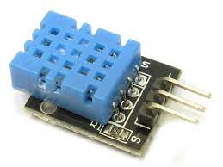
Temperature and Humidity
To measure temperature and humidity, the robot is equipped with a temperature and humidity sensor allowing it to get precise information on it.
The pins on the sensor include Power, Vout and Ground. The Vout pin is from where the information of the temperature and humidity goes into the Arduino board.

Slide 5
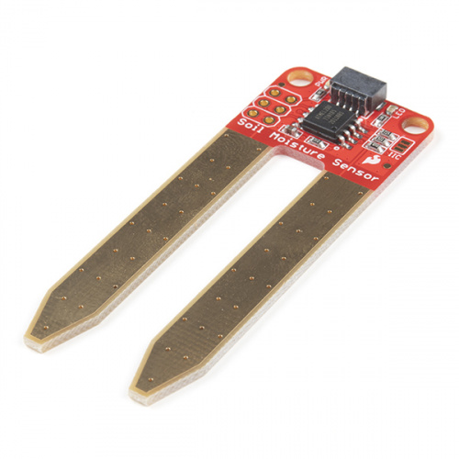
Soil Moisture
The robot is built with a soil moisture sensor allowing it to get information on the moisture level of the soil around it.
This can be utilized to check whether plant growth is possible within the area.
The pins on the sensor include Power, Ground and Signal. The signal pin is from where the information goes into the Arduino board.

Slide 6
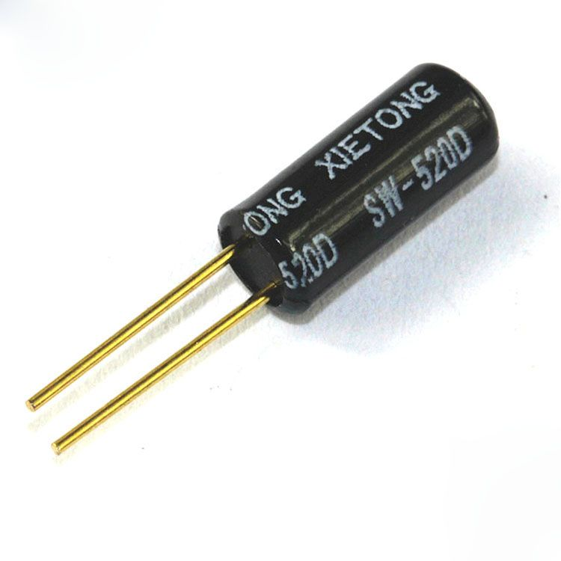
Land Tilt
Land tilt is measured with the help of a sensor called the Tilt Sensor. This sensor allows the robot to know whether the land is tilted or perfectly horizontal.
The pins on the sensor include Terminal 1 and Terminal 2.

Slide 7
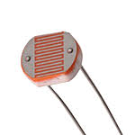
Sunlight
The sunlight is measured with the help of the photoresistor. This device allows resistance to be changed depending on the amount of sunlight falling on it, thus allowing it to measure the sunlight.
Like the tilt sensor it only has 2 pins which are Terminal 1 an Terminal 2

Slide 8
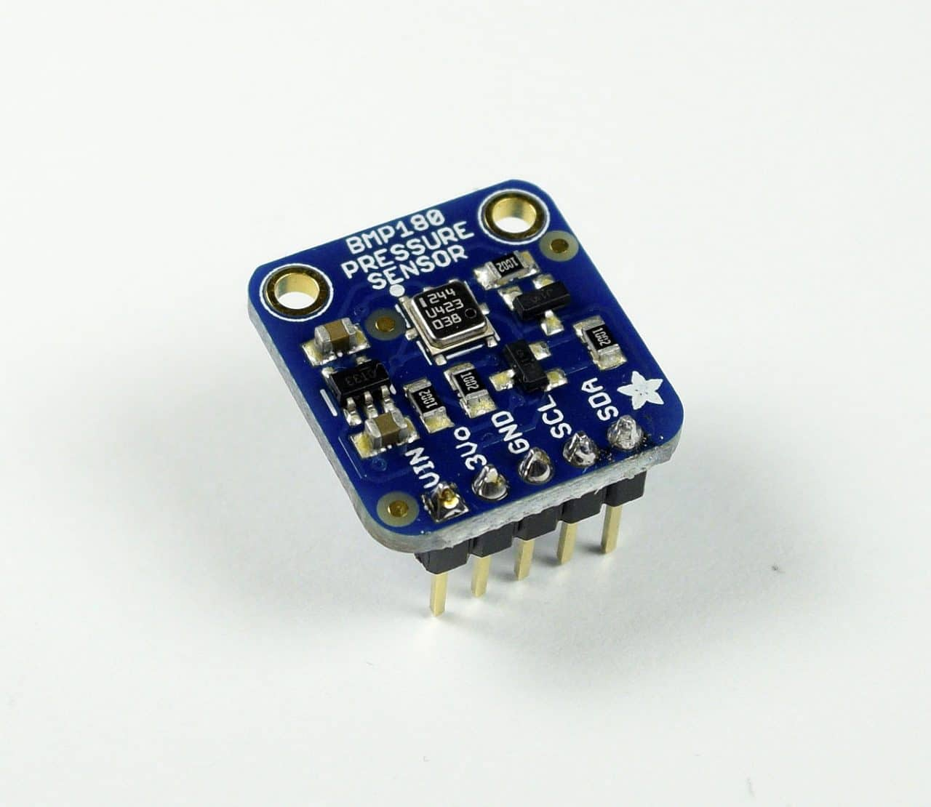
Atmospheric Pressure
The robot is equipped with a barometer sensor allowing it to get accurate pressure details in the area around it.
The pins on it include the Power, Ground, Serial Clock line, and the Serial Data.

Slide 9
The Sustainable Development Goals Achieved:
Climate Action (SDG 13):
Climate change is a real and undeniable threat to our entire civilization. The effects are already visible and will be catastrophic unless we act now.
Through education, innovation and adherence to our climate commitments, we can make the necessary changes to protect the planet.
These changes also provide huge opportunities to modernize our infrastructure which will create new jobs and promote greater prosperity across the globe.

Slide 10

Thank You

